Slide 1
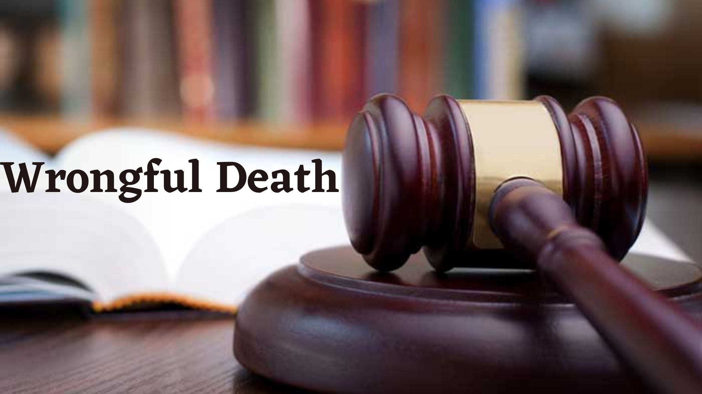
Wrongful Death and its Types

Slide 2
What is Wrongful Death?
Wrongful death occurs when the negligent or deliberately harmful actions of an individual, company, or entity causes another person to be killed. Wrongful death claims often arise from accidents caused by unsafe premises or products and medical malpractice, including auto, large truck, and motorcycle accidents, elder abuse, and workplace accidents. The attorney representing the surviving family members must be able to demonstrate that the defendant acted negligently, and that his or her negligence caused the injury and death of the victim. If your loved one suffer an injury or death due to someone's negligent actions, you can sue that individual or company for wrongful death lawsuit.

Slide 3
Types of Wrongful Death Accidents
1. Premises Liability
2. Automobile Accidents
3. Medical Malpractice
4. Product Liability
5. Elder Abuse/Nursing Home Abuse

Slide 4
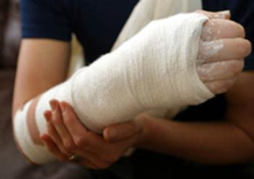
Premises Liability
Premises liability law pertains to injuries, including slip and fall injuries, caused by unsafe premises. The law requires that property owners maintain the safety of their property. When they fail to do so and their failure causes injury to a visitor, the property owner can be held liable for the injury.

Slide 5
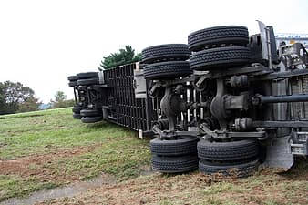
Automobile Accidents
It happens when a person died in a Car, Truck, Motorcycle accident due to recklessness and carelessness of a driver. Other Cause of road accident is Defective Roads, if there is any problem in construction of road you can sue them.

Slide 6
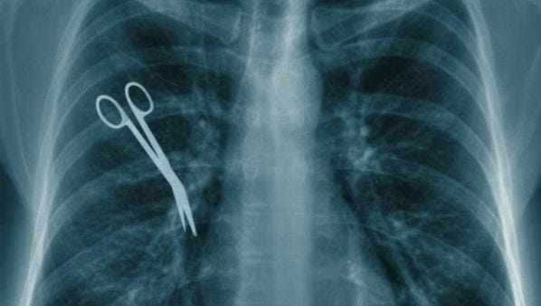
It Happens when someone you love has suffered a severe personal injury or if you have lost a member of your family to wrongful death due to a healthcare provider’s negligence. Surgical Errors and Diagnosis Error are some of the examples of Medical Malpractice.
Medical Malpractice

Slide 7
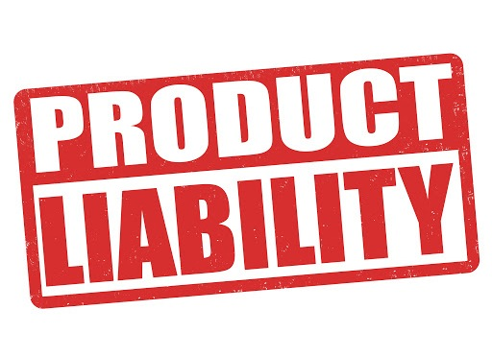
Product Liability
According to the doctrine of product liability, any or all parties involved in the design, manufacture, and marketing of a defective product may be held responsible for whatever injuries result from the use of the product. These parties must take reasonable measures to ensure that a product does not pose any unforeseeable hazards to consumers when used for its intended purpose.

Slide 8
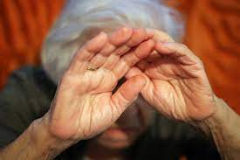
Elder/Nursing Home Abuse
In elder or nursing home abuse and neglect cases, it occurs when the elderly patient dies as a result of neglect, abuse or inadequate treatment or care. If your loved one has died due to negligence of nursing home abuse you can sue that elder care facility.

Slide 9
Contact Us
If you have lost a beloved member of your family due to someone else’s negligence, you need an experienced attorney to fight for your rights. Visit our Wrongful death law suit or Contact York Law Corporation to schedule a case evaluation with one of our wrongful death attorneys.
Our lawyers serve Sacramento, Fairfield, and surrounding North Bay Area communities.
Call our Sacramento Wrongful Death Lawyers Today! 800-939-1832
If you are looking for a wrongful death attorney Sacramento, we can help!

